Slide 1


Reducing Chronic Absence
Why does it matter? What can we do?
XXX DATE www.attendanceworks.org

Slide 2

About Us
Attendance Works is a national and state initiative that promotes awareness of the important role that school attendance plays in achieving academic success starting with school entry. We are an implementation partner for attendance with the Campaign for Grade Level Reading.
Our three focus areas to improve student attendance are:
              Build public awareness and political will
      Foster state campaigns
      Encourage local practice
www.attendanceworks.org

Slide 3

What is Chronic Absence?
Chronic absence is missing so much school for any reason that a student is academically at risk. Attendance Works recommends defining it as missing 10% or more of school for any reason.
Chronic
Absence
Excused
absences
Unexcused absences
Suspensions
Chronic absence is different from truancy (unexcused absences only) or average daily attendance (how many students show up to school each day).

Slide 4
Multiple Measures of Attendance
Average Daily Attendance
How many students show up to school every day? The percent of enrolled students who attend school each day. It is used in some states for allocating funding.
Truancy
Who is missing school without permission? Typically refers only to unexcused absences. Each state has the authority to define truancy and when it triggers legal intervention.
Who is missing so much school they are academically at risk? Broadly means missing too much school for any reason -- excused, unexcused, etc. Researchers commonly define it as missing 10% of school. OCR currently defines it as missing 15 days and will be releasing a report in Spring 2016. Chronic absence is a required reporting metric in ESSA.
Chronic
Absence

Slide 5
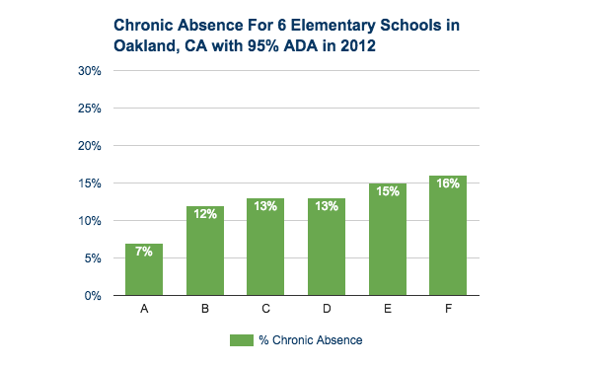
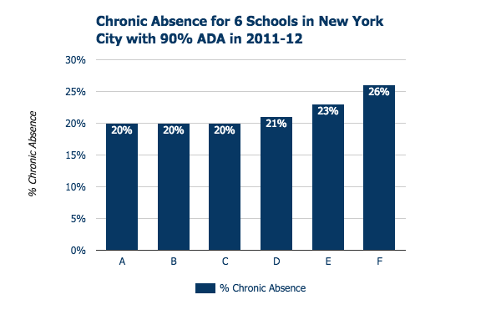
Average Daily Attendance (ADA)
Can Mask Chronic Absence
90% and even 95% ≠ A
98% ADA = little chronic absence
95% ADA = don’t know
93% ADA = significant chronic absence

Slide 6
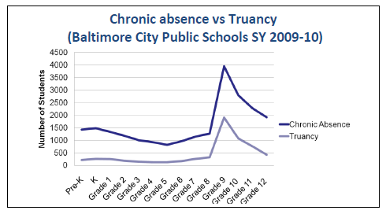
Truancy (unexcused absences) can underestimate chronic absence
Note: MD defines truancy as missing 20% of the school year.

Slide 7
Chronic Absence Vs. Truancy

Slide 8
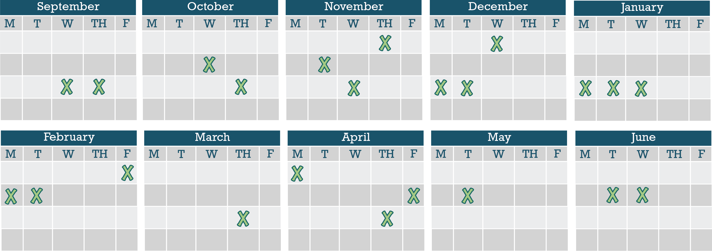
Chronic Absence Is Easily Masked If We Only Monitor Missing Consecutive days
Chronic Absence = 18 days of absence = As Few As 2 days a month
Notes:
It’s easy not to notice when your child may be missing too much school. 10% of a school year is about 18 days of absence. That sounds like a lot but when you break it down, that’s just two days a month. Most parents don’t get too stressed out if their child misses two days of class in a month. But when it happens month after month, it becomes a problem. Why?

Slide 9
Why Does Attendance Matter for Achievement?
What we know from research around the country

Slide 10

Why Does Attendance Matter?
Attainment Over Time
Achievement Every Year
Attendance Every Day
Advocacy For All
4 A School Success Framework
  Developed by Annie E. Casey Foundation & America’s Promise Alliance
  For more info go to http://www.americaspromise.org/parent-engagement-toolkit

Slide 11
Improving Attendance Matters Because it Reflects:
  Exposure to language: Starting in Pre-K, attendance equals exposure to language-rich environments especially for low-income children.
  Time on Task in Class: Students only benefit from classroom instruction if they are in class.
  On Track for Success: Chronic absence is a proven early warning sign that a student is behind in reading by 3rd grade, failing courses middle and high school, and likely to drop-out.
  College and Career Ready: Cultivating the habit of regular attendance helps students develop the persistence needed to show up every day for college and work.
  Engagement: Attendance reflects engagement in learning.
  Effective Practice: Schools, communities and families can improve attendance when they work together.
(For research, see: http://www.attendanceworks.org/research/)

Slide 12

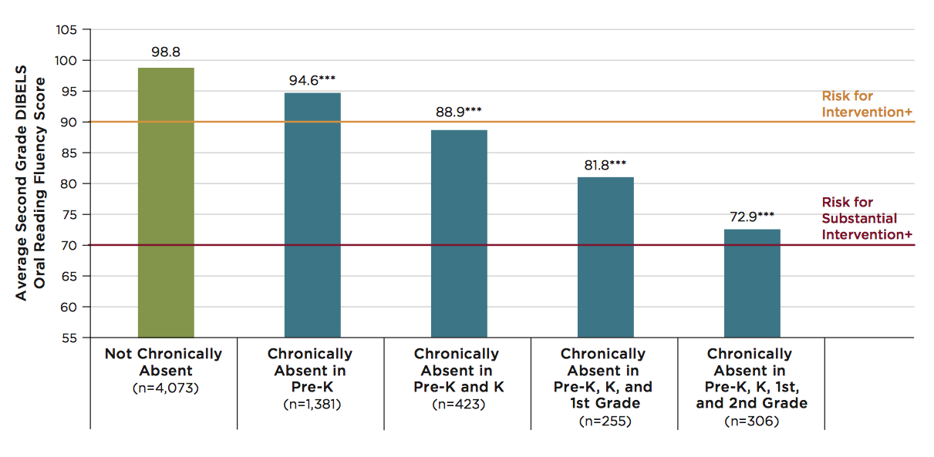

Multiple Years of Chronic Absenteeism = High Risk for low 3rd Grade Reading Skills
Note: ***Indicates that scores are significantly different from scores of students who are never chronically absent, at p<.001 level. + In the DIBELS 6th Edition Assessment and Scoring Guide (Good & Kaminksi, 2002), these are labeled as “Some Risk,” indicating the need for additional intervention and “At Risk,” indicating the need for substantial interventions.
Notes:
The impact increases with multiple years of chronic absence. Experience indicates turning chronic absence around within 2 two years leaves a reasonable opportunity for students to recuperate academically from the lost time. Three consecutive years or more of chronic absence leaves gaping deficits. For principals this puts a very high priority on preventing or abating chronic absence from the outset of schooling.

Slide 13
Chronic Early Absence Connected to Poor Long- Term Academic Outcomes
Chronic absence in kindergarten
Lower levels of
literacy in first grade
Lower achievement as far out as fifth grade
A Rhode Island Data Hub analysis found that compared to kindergartners who attend regularly, those chronically absent:
Scored 20% lower in reading and math in later grades and gap grows
2X as likely to be retained in grade.
2X likely to be suspended by the end of 7th grade.
Likely to continue being chronically absent
Notes:
Chronic early absence is the percentage of children in grades K-3 that miss 10% or more of the school year (or 18+ days in a 180-day school year).
Research shows that children who are chronically absent in kindergarten
Show lower levels of literacy in 1st grade
AND that chronic absence in kindergarten can predict lower achievement as far out as the 5th grade.
It is easy to overlook the prevalence of chronic early absence and think you don’t have an attendance problem if you only look at average daily attendance.
BUT in 2012, Rhode Island’s 4 core cities had an average daily attendance rate of 94%, BUT almost 1 in 5 students (19%) were chronically absent.
Chronic early absence can be reduced by using data to regularly identify and intervene with students who have multiple absences, engaging, educating and providing supports for families, personalizing the educational experience for all students, and educating communities to support school attendance.

Slide 14
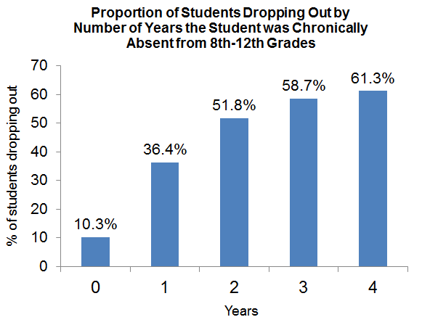
The Effects of Chronic Absence on Dropout Rates Are Cumulative
Proportion of Students Dropping Out by Number of Years the Student was Chronically Absent from 8th-12th Grades
http://www.utahdataalliance.org/downloads/ChronicAbsenteeismResearchBrief.pdf

Slide 15
How Can We Address Chronic Absence?

Slide 16
Unpack contributing factors to chronic absence
Myths
Absences are only a problem if they are unexcused
Sporadic versus consecutive absences aren’t a problem
Barriers
Lack of access to health or dental care
Aversion
Child struggling academically or socially
Bullying
Attendance only matters in the older grades
Poor Transportation
Trauma
No safe path to school
Ineffective school discipline
Parents had negative school experience
Disengagement
Lack of engaging and relevant instruction
No meaningful relationships with adults in school
Vulnerable to being with peers out of school vs. in school
Poor school climate
Undiagnosed disability
Homelessness

Slide 17
Recognize that Going to School Reflects When Families Have
Hope
for a better future
Faith
that school will help you or your child succeed
Capacity
Resources, skills, knowledge needed to get to school

Slide 18
Recommended Site-Level Strategies
E. Develop Programmatic Response to Barriers
A. Recognize Good and Improved Attendance
B. Engage Students and Parents
D. Provide Personalized Early Outreach
C. Monitor Attendance Data and Practice

Slide 19
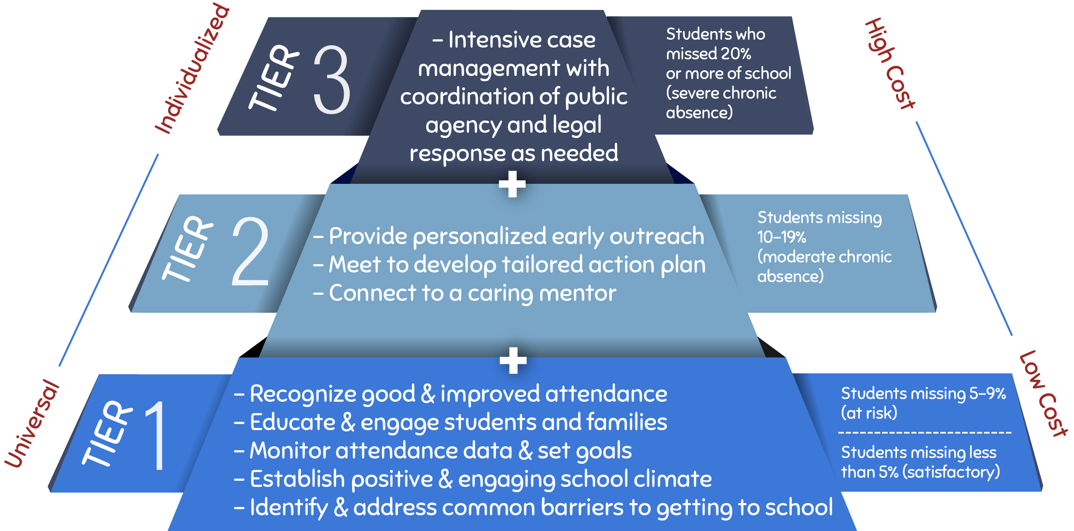
Invest in Prevention and Early Intervention

Slide 20
Tier 1: Family Engagement Strategies
Tier 1
Family engagement strategies powerful enough to enable families to successfully partner with the school for academic success without any further intervention.
Who are the families in Tier 1?
Families of all students enrolled in your school
For which families is Tier 1 sufficient?
Families who partner with the school
Families who have had good experiences with school in the past

Slide 21
Tier 1: Creating a positive, engaging school climate that supports attendance
Attendance is higher when schools:
Promote a sense of belonging and connection including noticing when students show up
Make learning engaging so students don’t want to miss class Engage in restorative practice not punishment
Meet the basic needs of our most economically challenged families so all have the opportunity to get to school
Build awareness about how absences can easily add up to too much time lost in the classroom

Slide 22
Parents underestimate the number of year-end absences
Missed an average of 2+ days per month 90%
We asked each parent about his or her child’s absences in two ways:
Was your child absent an average of 2 or more days a month?
Was your child absent more than 10 days over the year?
60% of parents said their child was absent an average of 2+ days a month, but not 10+ days a year
Missed 10+ days annually 30%
The math: If a child is absent an average of 2+ days a month, then he/she is absent far more than 10+ days a year

Slide 23
Schools inadvertently reinforce some absence-causing beliefs
Reinforce Attendance
Class rewards for good attendance (e.g. popcorn or ice cream parties)
Reinforce Absenteeism
Impersonal letters
Individual recognition for students with good attendance
Teachers send work home in response to absences
Teachers do not address absenteeism issue with the parent
Parents do not feel their child is safe in school
High levels of absenteeism in the class
Impersonal Letters:
Easy to disregard
Many parents felt the school miscounted—but parents couldn’t verify because they weren’t tracking absences
Many parents felt that the school didn’t understand them
Sending Work Home:
Parents thought that completing a makeup packet caught their child up for the missed day’s work
Teachers Not Addressing Absenteeism:
Most parents reported that they regularly communicate with their children’s teacher, but never about absences
Big motivators for kids, but not for parents
Reinforces parents’ existing attitudes & behaviors

Slide 24

Parent Video & Discussion Guide
Bringing Attendance Home
Video (6 minutes)
Facilitated conversation
  The consequences of chronic absence
  How to improve absenteeism
    Family practice
    Increase social capital
    Identify how school can help
    Community services
http://www.attendanceworks.org/tools/for-parents/bringing-attendance-home-video

Slide 25

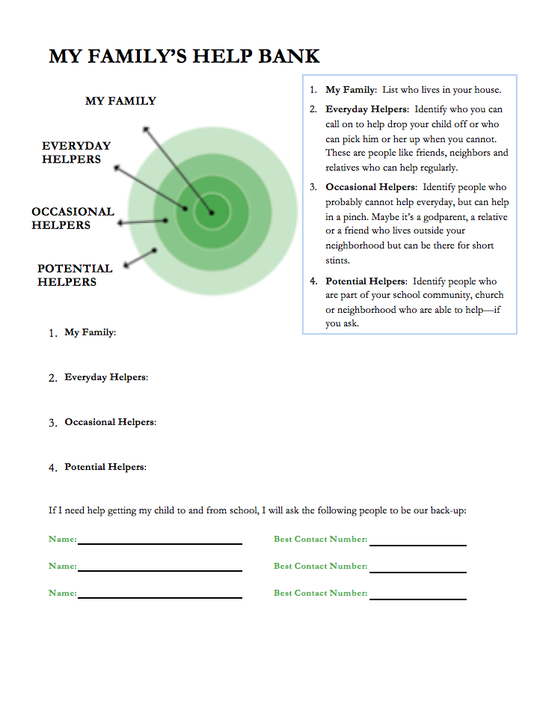

Help families make back-up plans

Slide 26
Tier 2 Interventions
Tier 2
Targeted interventions that remove identified barriers and increase positive connections that motivate improved attendance.
Who are the families in Tier 2?
Missing 10% or more of the prior or current school year for any reason.
For which families is Tier 2 sufficient?
Families with barriers to school attendance who may not understand how to access support.
Families experiencing some challenge e.g. chronic disease, job loss, divorce, etc.
Families who see school as “the deliverer of bad news.”
Families who are more successful when there is a positive relationship with someone at the school.

Slide 27
Criteria for Identifying Priority Students for Tier 2 Supports
Chronic absence (missed 10% or more of school) in the prior year, assuming data is available.
And/or starting in the beginning of the school year, student has:
In first 2 weeks
2 absences
In first month (4 weeks)
2-3 absences
Missing 10% any time after
In first 2 months (8 weeks)
4 absences

Slide 28
The first month of school predicts chronic absence
Baltimore students who missed 2-4 days of school in September were 5 times as likely to be chronically absent.
Students who missed 5 or more days of school in September were 16 times as likely to be chronically absent.

Slide 29
Possible Tier 2 Interventions
Positive Linkages and Engagement for Students and Families
Assign caring mentors
Partner with families/students to develop Student Attendance Success Plan
Offer plan or contacts for health support
Recruit for engaging before-or-after-school activities
Connect to Walk-to-School Companion

Slide 30
Tier 3 Interventions
Tier 3
Tier 3 provides intensive interventions, often from multiple agencies or specialists within a school district or community.
Who are the families in Tier 3?
Missing 20% or more of the prior or current school year for any reason.
For which families is Tier 3 sufficient?
Families who feel hopeless because of the barriers they face.
Already involved in the system (child welfare, juvenile or criminal justice).
Families who are unable to experience success without intervention.
Families who have a negative relationship with school.
Families who require ongoing support for sustained success.

Slide 31
Who can help families in Tier 3?
Community schools
Head Start family liaisons
School integrated service teams
Family resource centers
McKinney Vento representatives
Public agencies
Who would you add to this list?

Slide 32
What might educators and community partners say to families?
1
Learn
Learn about the student’s family. Ask what their vision is for their child’s future. What are their hopes and dreams for them?
2
Share
Share positive things you’ve observed about the student. Share your own vision for student learning & development, including helping put students on a pathway to success by encouraging a habit of good attendance.
3
Inform
Review attendance report with parents. Tailor conversation to student’s level of absenteeism & inform parents of possible impacts of missing school. Connect attendance to parents’ hopes and dreams for their child.
4
Discuss the challenges parents face in getting their children to school, as well as strengths they can build upon. For chronically absent students, try to understand the barriers that are keeping their children from school.
Discuss
5
Arrive at
a Plan
Think through strategies with parents for addressing absences and help them develop an attendance improvement plan. Offer referrals to services as needed and ask if there are other ways you can help.

Slide 33
Take a Data Driven Systemic Approach
Positive Engagement:
Uses caring relationships, effective messaging and a positive school climate to motivate daily attendance.
Actionable Data:
Is accurate, accessible, and regularly reported in an understandable format.
Community
District
Positive Engagement
Actionable Data
Schools
Students & Families
Shared Accountability
Capacity Building
Capacity Building
Expands ability to work together to interpret data, engage in problem solving, and adopt best practices to improve attendance.
Shared Accountability:
Ensures chronic absence is monitoring & reinforced by policy
Strategic partnerships
between district and community partners address specific attendance barriers and mobilize support for all ingredients
Notes:
At same time, we know schools and communities can understand why kids aren’t in school and turn attendance around when they implement these five strategies with fidelity. How schools carry them out can be tailored to their own realities and strengths.
Then – I go through and offer examples of what each one of these might look like. I also clarify that recognizing good and improved attendance isn’t just providing perfect attendance awards for a semester or year– which doesn’t help to motivate improvement among the students with the most problematic attendance.

Slide 34
Proposed Pathway for Change:
Cultivating peer learning to inform broader policy change and practice
Advance practice through peer learning
Inform actions w/ insights from local practice
Spread work through TA and policy
Advance practice through peer learning
Locality A
Locality B
Locality C: Early Innovator
Locality C
  Policymakers
  Education Leaders & Assoc. (K-12 & ECE)
  Associations of public health agencies (housing, health, social services, transportation
  Unions
  Parent Organizations
  Advocacy organizations
  Philanthropy
  Others
Ongoing peer learning,
technical assistance, administrative guidance, regulations, legislation, etc. promote best practices & systemic change
Peer opportunities to:
Compare data
Share, demonstrate & learn about best practices
Identify & problem-solve common challenges

Slide 35
Additional Resources

Slide 36
What tools are available to calculate chronic absence?
FREE FROM ATTENDANCE WORKS!
District Attendance Tracking Tools (DATT) and School Attendance Tracking Tools (SATT) Analyzes absences across grades, schools, most sub-populations.
Available in Three Modules (Grades PreK-5; Grades 6-8; Grades 9-12 plus tool to create K-12 report)
Excel-based tool usable with most data systems.
Go to: http://www.attendanceworks.org/tools/tools-for-calculating-chronic-absence/

Slide 37
Superintendent’s Call to Action
Own the issue
Mobilize the Community
Drive with Data
To sign-up for the Call to Action, or to learn more, please visit: www.attendanceworks.org/superintendents-call-to-action

Slide 38

Chronic absence is like a warning light on your car dashboard
THANKS!
Any questions?
You can find me at @attendanceworks & hedy@attendanceworks.org
The Parallels:
Ignore it at your personal peril!
Address early or potentially pay more (lots more) later.
The key is to ask why is this blinking? What could this mean?

Slide 39
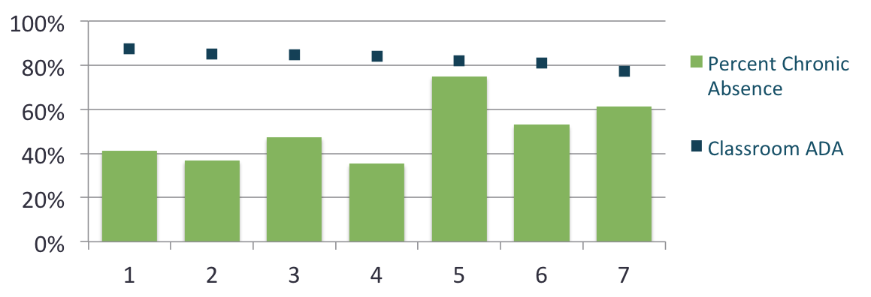
Chronic Absence Can Vary Widely by Classroom
Chronic absence vs. ADA across 7 preschool classrooms in one early childhood center with 84.46% ADA
Source: Average Enrolled Attendance for month of February 2013

Slide 40
Chronic absence is especially challenging for low-income children
Poor children are 4x more likely to be chronically absent in K than their highest income peers.
Children in poverty are more likely to lack basic health and safety supports (health care, transportation, stable housing, food, clothes, etc.) that ensure a child is more likely to get to school.
The adverse impact of absenteeism on literacy development is 75% greater for these children than for their middle class peers.
* (Romero & Lee 2007)

Slide 41
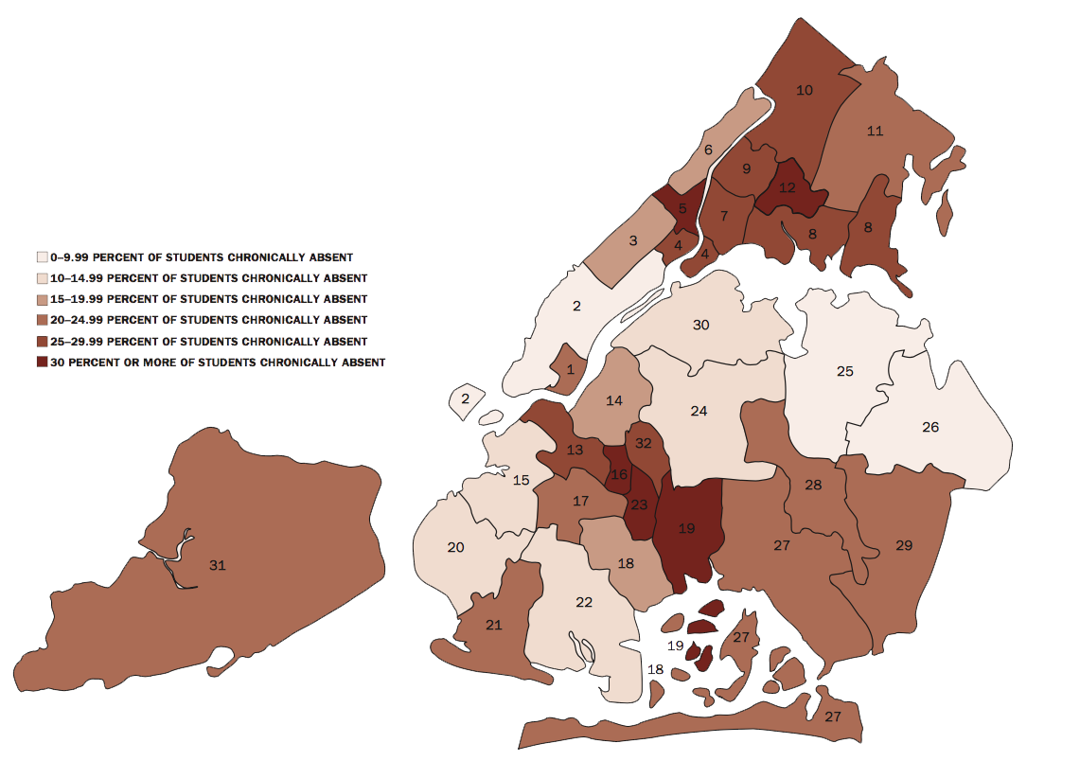
In NYC, chronic elementary school absence is higher in low-income neighborhoods
Source: Better Picture of Poverty: New School November 2014

Slide 42
Who Makes a Difference?
Children: When they get excited about coming to preschool every day and convey that enthusiasm to their parents and caregivers.
Families: When they understand that preschool absences matter, feel welcome and respected, value their children’s attendance and seek help as needed to overcome barriers.
Staff: When they create a positive first school experience and build attendance messaging, tracking, problem-solving and celebrating into preschool routine.
Community: When partners reinforce messaging and provide resources to help families overcome barriers to attendance.

